Slide 1
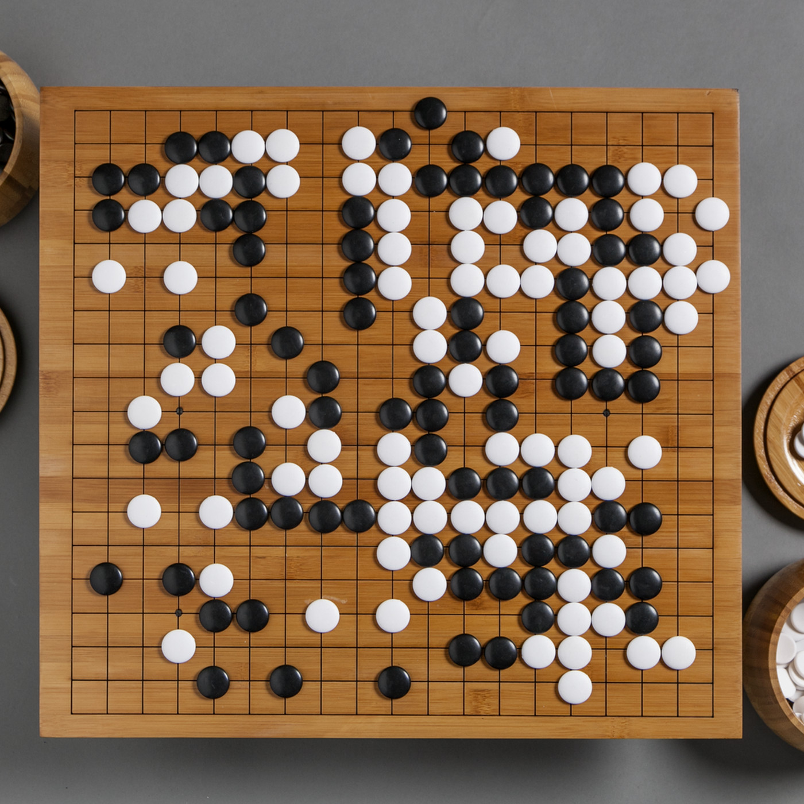
CSCI 599: ZeroGo
Solving the game of Go with ML
Sunny Patel
Jing Ouyang
Wesam Alwehaibi

Slide 2
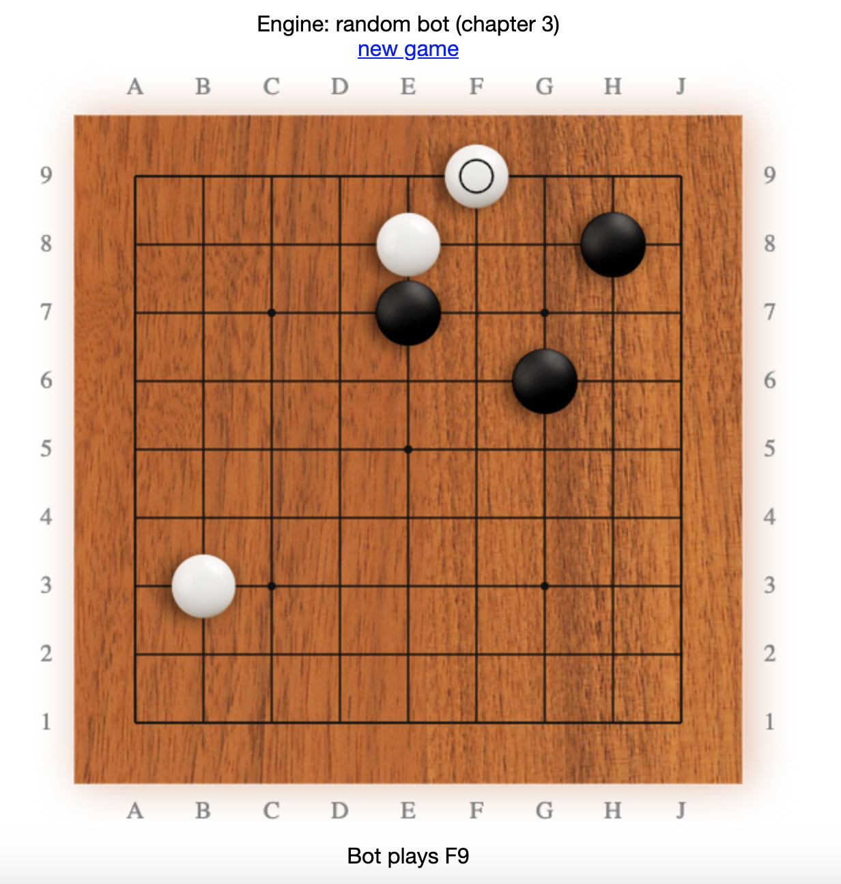
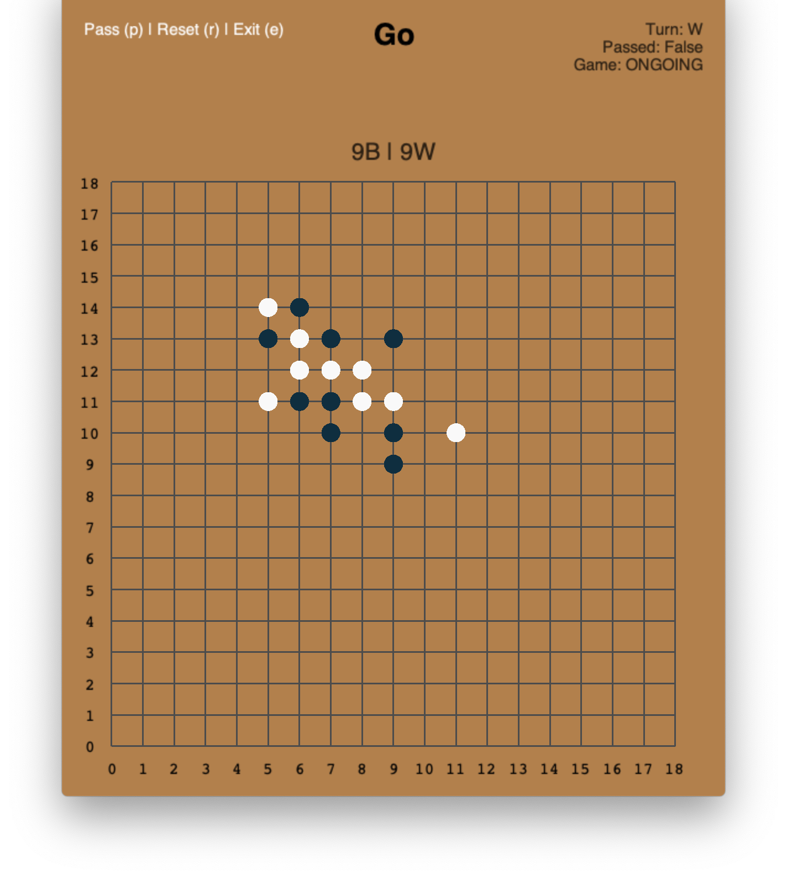
Week 6: What we did last week?
Try to build a UI tool with human-bot and bot-bot mode.
Own Implementation GymGo

Slide 3
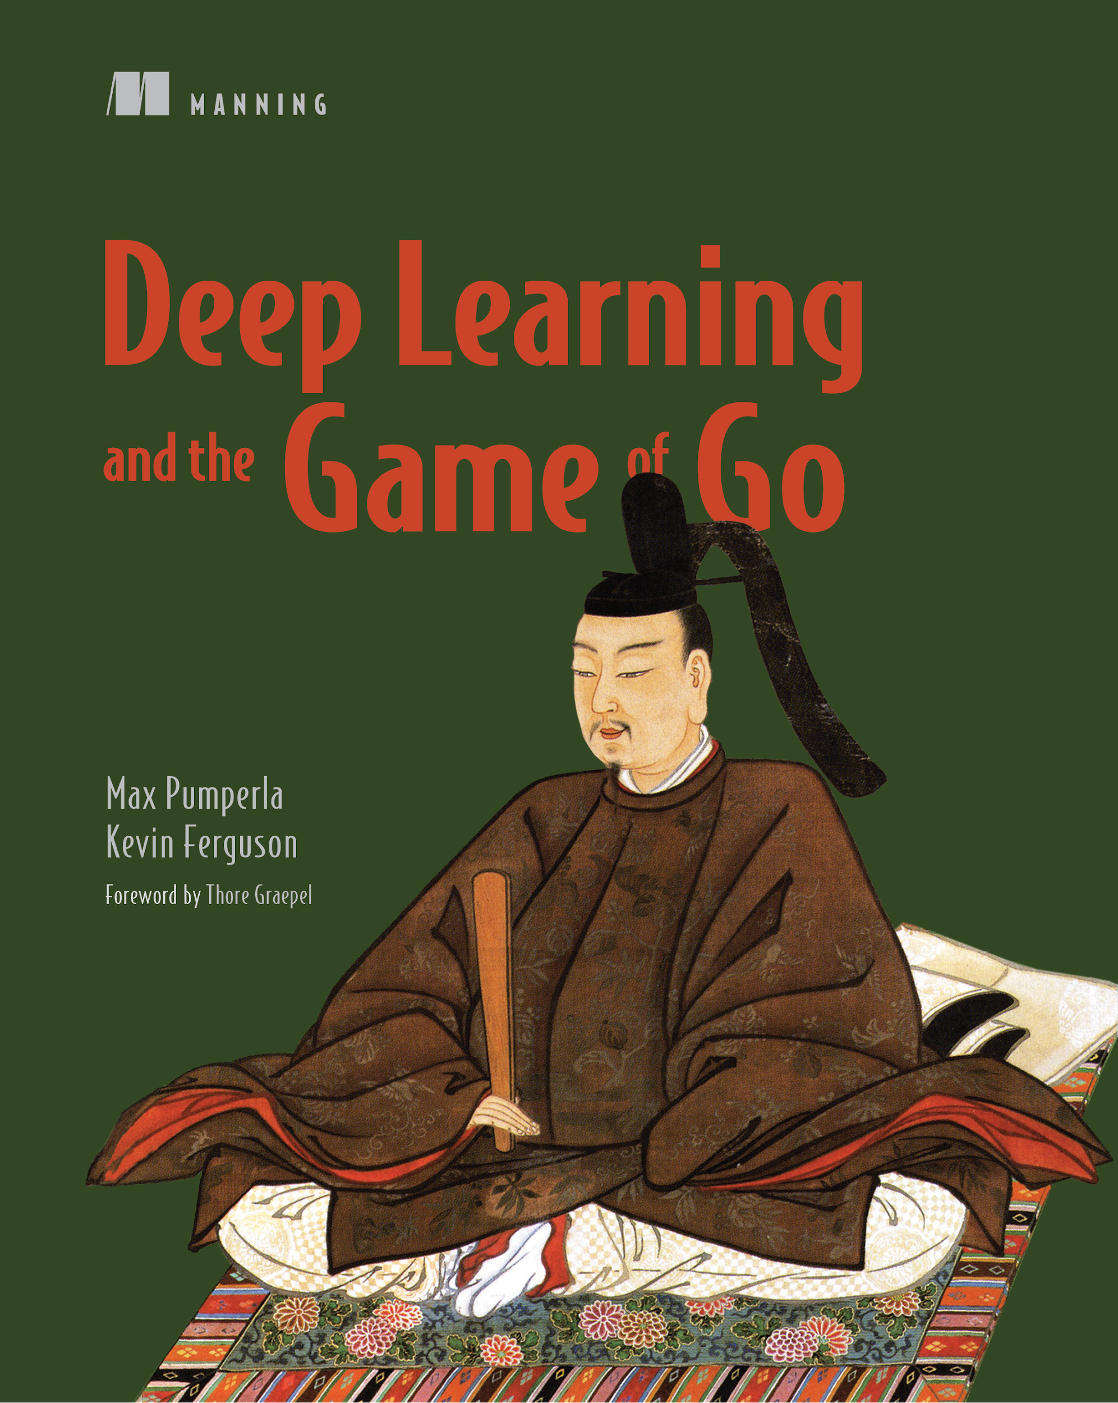
Week 6: What we did last week?
Continued studying algorithms that can help

Slide 4
Week 6: Agents Developed
Neural Networks - Training phase
Reinforcement Learning - WIP

Slide 5
Training methods
Training NN on the games available on the internet. (These games are actual matches that human experts played)
2 Neural trained agents playing in Reinforcement fashion to collectively improve the weights of NN

Slide 6
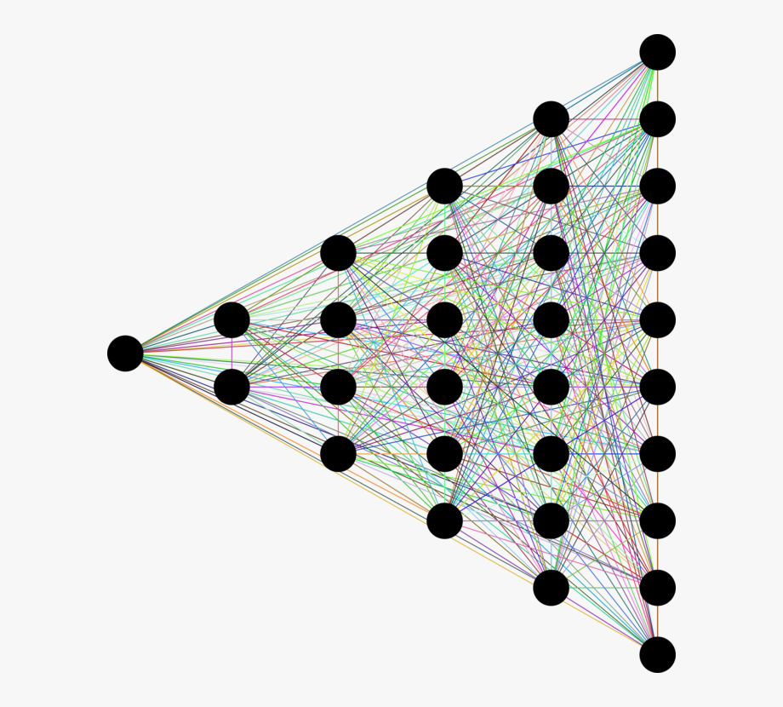
NN Training Process
Download historical game data as SGF
Extract data and encode as a simpler data format
Train Deep NN using the encoded data
Improve and tune the Deep NN
Use trained network as part of an end-to-end go bot
(;FF[5]GM[1]SZ[6]
AB[bb:ee]
;AW[bb][ee][dc][cd]
;AW[cb][bc][be][eb][ed][de]
;AE[dc][cd]
)
0 | 0 | -1
0 | -1 | 0
0 | 1 | 0

Slide 7
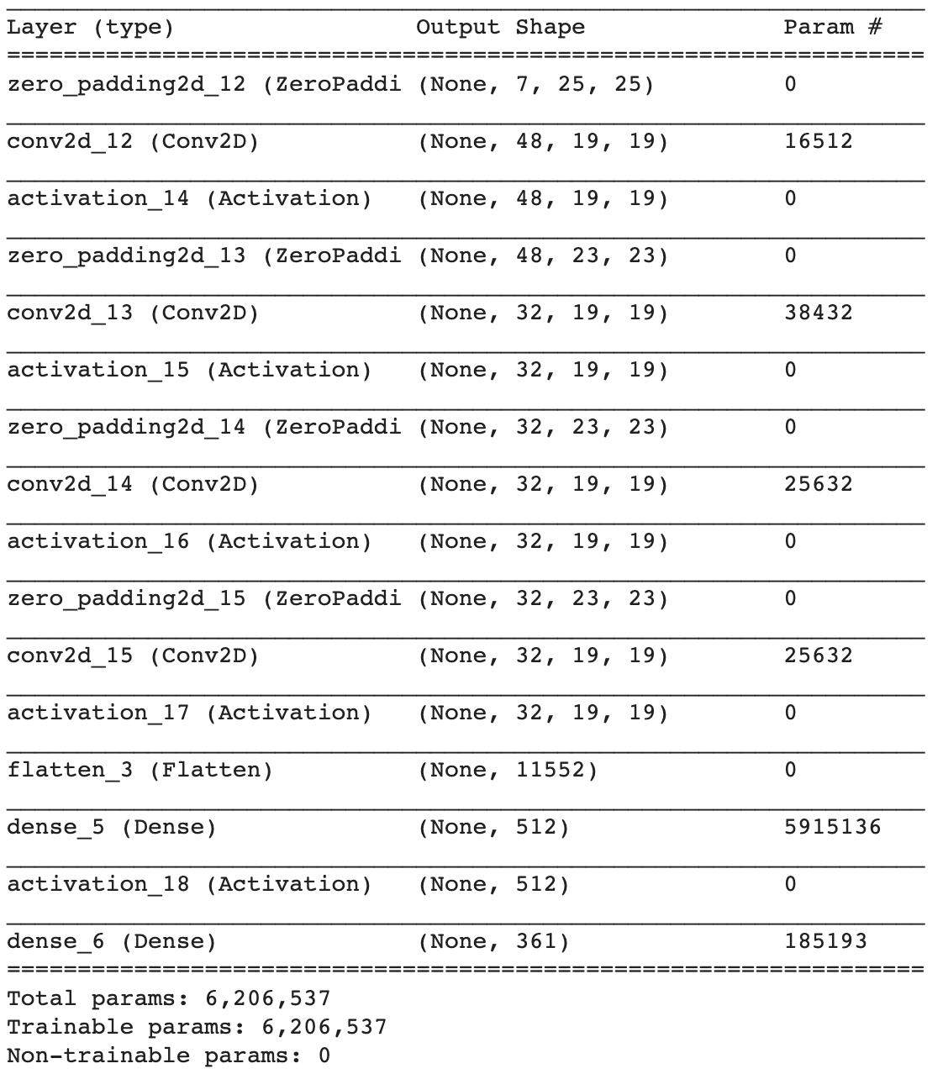
NN Structure
Seven-plane board encoder
Zero-padding + Conv2d * 48
Zero-padding + Conv2d * 32
Zero-padding + Conv2d * 32
Zero-padding + Conv2d * 32
Flatten + Dense (512)
Flatten + Dense (361)

Slide 8
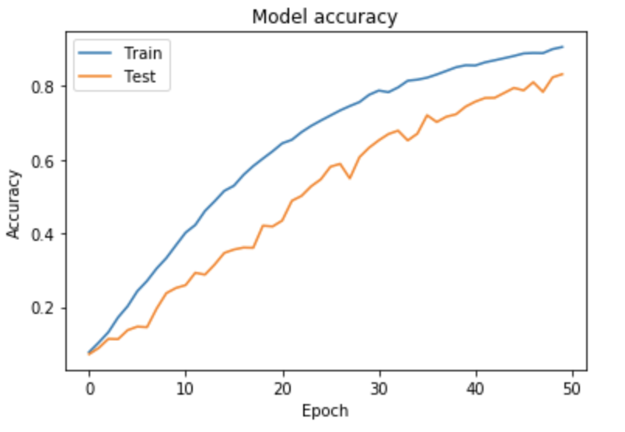
NN Performance
Hyper-params:
6M trainable params
100 games
50 epoches
Batch size: 128

Slide 9
NN Training Time
Time/epoch | Small network | Large Network
Local mac | 60s | 3600s
Colab (GPU) | 2s | 240s
GCP (GPU) | To be tested | To be tested

Slide 10
NN Agent Play
Agent so far:
Pretty naive
Cannot catch critical moves
Cannot beat minimax/mcts agent

Slide 11
NN Agent to-dos
More training data
Try GCP (more stable than Colab)
Larger network
More epochs, data shuffling
Tune hyper-params, experiment with different optimizers (Learning rate, Leaky-Relu, Adaboost , adam, etc.)
Combine with RL

Slide 12
Week 7-8: What do we plan to do next?
Continue Training NN
Continue working on Reinforcement learning
Start thinking of combining algorithms and finding heuristics
Continue developing the UI
Work on deploying the UI as a web service

